Slide 2
STUDENT ACCOUNTABILITY CONTRACT

Slide 3
DRESS CODE

Slide 4
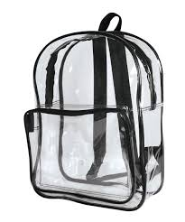
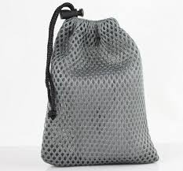
Clear Bookbags / Mesh Gym Bags

Slide 5
Water Bottle /Unopened Drink for Lunch

Slide 6
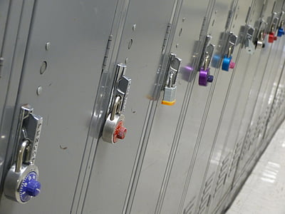
Lockers/ Locks
Lockers and locks have been assigned to all students. If you lose your lock, a replacement costs $7.50.
Storing contents for a friend in your locker, makes you responsible for legal/illegal items.

Slide 7
CHROMEBOOKS
You are responsible for your Chromebook (leaving, abusing, etc.)
Leaving Chromebook @ home = Chromebox use in class (No library visit)
Inappropriate searches
Only library visit for Chromebook if out for repair
Will not issue Chromebook until paperwork is returned

Slide 8
Safety
All school doors must be closed and locked at all times!! No one should prop doors!
Refrain from letting anyone inside the building without teacher or administrator permission.

Slide 9
In your locker
Texting / calling parents
Instigating arguments / fights
Bullying
Videoing / Posting pics and videos
Notes:
Cell phone expectations

Slide 10
Infraction | 1st Offense | 2nd Offense | 3rd Offense
Fighting, Assaults, Threats, Harassment, Bullying | 5-10 days out of school suspension | 10 days out of school suspension, long term suspension, expulsion, referral to Shaw Academy | 10 days out of school suspension, long term suspension, expulsion, referral to Shaw Academy
Weapons, Bomb Threat | 10 days out of school suspension, long term suspension, expulsion, referral to Shaw Academy | 10 days out of school suspension, long term suspension, expulsion, referral to Shaw Academy | 10 days out of school suspension, long term suspension, expulsion, referral to Shaw Academy
Gang Related Activities | 5 days out of school suspension | 10 days out of school suspension | 10 days out of school suspension, long term suspension, expulsion, referral to Shaw Academy
Drugs and Alcohol (possession, influence, distribution) | 5 days out of school suspension | 10 days out of school suspension | 10 days out of school suspension, long term suspension, expulsion, referral to Shaw Academy

Slide 11
Constant name calling, hitting, teasing, insulting, physical threats, etc.
Spreading rumors, encouraging others to exclude the person, writing hurtful things for public to see
Posting hurtful messages on social media, recording unauthorized videos/pics that are hurtful and uploading them;
Intimidating looks & gestures
Threatening aggression against people, possessions, or property
1st OFFENSE | 2ND OFFENSE | 3RD OFFENSE
Up to 10 days OSS/ALA/possible LTS | Up to 10 days OSS/ALA/possible LTS | Up to 10 days OSS/ALA/possible LTS

Slide 12
PORNOGRAPHY
INSTIGATORS
THREATS / JOKING
Vandalism
CHROMEBOOKS

Slide 13
BUS/Car Rider DISMISSAL
YOU MAY LEAVE YOUR CLASSROOM ONLY WHEN YOUR CAR RIDER / BUS NUMBER is listed on the classroom screen.

Slide 14
Riding a bus is a privilege!
Notes:
Bus behavior expectations

Slide 15
Let us know if you see or hear anything that could jeopardize your safety or others!

Slide 16
Nine Week Events
Weekly TLC
Passports
8th Grade Formal
Drawings
School Store

